Slide 1

CLIMATE ACTION AND ADAPTATION PLAN
Public Workshop No. 2
December 8, 2020

Slide 2
Workshop Goals and Logistics
Provide information, answer questions, and gather feedback
Use of “Chat” and/or “Q&A” button
Use “Raise Hand” button to speak
November 18, 2020 – Workshop #1(What is a CAAP? Why its needed?, CAAP development Process, and Greenhouse Gas (GHG) Inventory and Forecasts)
December 8 2020 – Workshop #2 (GHG Reduction Targets and Reduction Measures)

Slide 3
CAAP Public Workshop #1 on November 18, 2020
Re-cap and Key Questions
-Is the CAAP aspirational or legally binding?
-What is the City’s participation in the Clean Power Alliance (CPA) program?
-Can we establish a micro-grid in the City?

Slide 4
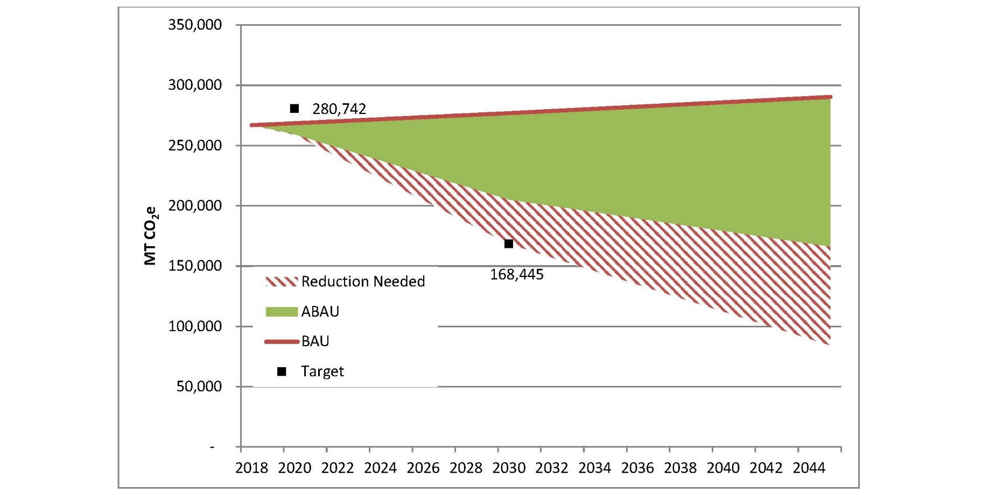

Slide 5
Filling the GHG Emissions Gap: Agoura Hills Community GHG Reduction Measures
Emissions Category
Effected Land Use
Goals
Residential/Commercial Energy, On-Road Transportation, Water/Wastewater, Solid Waste, Advanced Measures, Clean Energy
Residential and Commercial Land Uses
Objectives
Supporting Measures and Actions
Target Year
Performance Metric
Year 2030
Programs, Policies, Ordinances or Projects
Metric to measure achievement of goal

Slide 6
1. Energy Efficiency
Existing Residential
Goal 1: Increase Energy Efficiency in Existing Residential Units
Measure 1.1 Energy Efficiency Training, Education, and Recognition in the Residential Sector Actions: Designate ‘Energy Advocate/Sustainability’ Staff, Promote energy efficiency education, training and fairs
Measure 1.2 Increase Community Participation in Existing Energy Efficiency Programs Actions: Partner with SCAG, SCE and SoCal Gas for energy efficiency outreach and training
Measure 1.3 Promote Home Energy Evaluations Actions: Energy efficiency audits through existing programs, residential sector energy conservation disclosure
Measure 1.4 Residential Home Energy Renovations Actions: Promote existing home energy renovation programs, participation in green building programs (LEED, PACE, HERO, Energy Upgrade California, Low Income Home Improvement Programs), Establish online permitting

Slide 7
1. Energy Efficiency
New Residential
Goal 2: Increase Energy Efficiency in New Residential Units
Measure 2.1 Exceed Existing Energy Efficiency Standards
Actions: Educate developers and City staff on future Title 24 updates, new energy efficiency opportunities , Promote Tier 1 and Tier-2 green building ratings (LEED, Energy Star Certified Buildings etc.), Provide recognition and incentives to developers for all electric homes development

Slide 8
1. Energy Efficiency
Existing Commercial
Goal 3: Increase Energy Efficiency in Existing Commercial Units
Measure 3.1 Energy Efficiency Training, Education, and Recognition in Commercial Sector Actions: Designate ‘Energy Advocate’ Staff, Promote energy efficiency education, training and fairs
Measure 3.2 Increase Business Participation in Existing Energy Efficiency Programs Actions: Partner with SCAG, SCE and SoCal Gas for energy efficiency outreach and training
Measure 3.3 Promote Non-Residential Building Energy Audits Actions: Energy efficiency audits through existing programs, Energy conservation disclosure for commercial sector
Measure 3.4 Non-Residential Building Retrofits Actions: Promote existing building retrofit programs, participation in green building programs (LEED, PACE, HERO, Energy Upgrade California etc.), Establish online permitting

Slide 9
1. Energy Efficiency
New Commercial
Goal 4: Increase Energy Efficiency in New Commercial Units
Measure 4.1 Exceed Tier 2 Voluntary Measures Energy Efficiency Standards
Actions: Educate developers and City staff on future Title 24 updates, new energy efficiency opportunities , Promote Tier 1 and Tier-2 green building ratings (LEED, Energy Star Certified Buildings etc.), Provide recognition and incentives to developers for all electric development

Slide 10
2. Water Efficiency
Goal 5: Increase Energy Efficiency through Water Efficiency
Measure 5.1 Improve Water Efficiency through continued Implementation of SB X7-7 Actions: Provide water efficiency training and education, low-irrigation landscaping
Measure 5.2 Exceed Water Efficiency Standards Actions: Outreach to HOA, businesses, community groups; promote use of re-cycled water, rainwater harvesting rebates

Slide 11
3. Advanced Goals and Measures
Goal 6: Decrease Energy Demand through Reducing Urban Heat Island Effect
Measure 6.1 Tree Planting for Shade and Enhancing Energy Efficiency Actions: Tree planting for new commercial development, create Community Tree Planting Group
Measure 3.2 Light Reflecting Surfaces for Energy Efficiency Actions: Promote cool roofs and cool pavements

Slide 12
4. On-Road Transportation
Goal 7: Decrease GHG Emissions Through a Reduction in Vehicle Miles Travelled (VMT)
Measure 7.1 Alternative Transportation Options Actions: Work with SCAG, County and community to remove barriers to alternative transportation, Promote biking and non-motorized transportation
Measure 7.2 Implement Bicycle Masterplan to Expand Bike Routes Around the City Actions: Establish Bicycle Advisory Committee, Engage community including school officials and students
Measure 7.3 Ridesharing and Bike to Work Programs within Businesses Actions: Facilitate Air District incentives for businesses to establish ride sharing, Provide reserved preferential parking spaces, businesses of certain size to provide bike racks and showers
Measure 7.4 Electrify the Fleet Actions: Promote EV incentive programs, apply for grants to establish e-chargers, require or incentivize new commercial development to install e-chargers

Slide 13
5. Solid Waste
Goal 8: Decrease GHG Emissions through Reducing Solid Waste Generation
Measure 8.1 Reduce Waste at Landfills
Actions: Create awareness regarding recycling, composting and waste diversion, additional recycling containers at public places

Slide 14
6. Clean Energy
Goal 9: Decrease GHG Emissions through Increased Clean Energy Use
Measure 9.1 Promote Clean Energy Actions: Promote clean energy incentives, encourage solar panel installations
Measure 9.2 Continued Participation in the CPA program Actions: Achieve renewable energy goals beyond State targets by participation in the CPA program at 100 percent renewable energy

Slide 16
Schedule
November 18, 2020 – Workshop #1 (Overview of CAAP)
December 8, 2020 – Workshop #2 (Reduction Measures)
February 10, 2021 – Approval of CAAP (Phase 1)
February - June 2021 – CEQA approval (Phase 2)
July 2021 – Transition to Phase 3 (Implementation)

