Slide 1
Housing Element Update
A Workshop for the public
Meeting will start at 6:00 PM
August 4, 2021
Notes:
Hello, I am Denice Thomas. Community Development Director for the City of Agoura Hills. Thank you so much for joining us this evening. Pursuant to Los Angeles County Health Order, since we are indoors, masks must be worn by everyone whether you are vaccinated or not. The seats have arranged to provide social distance between you. The purpose of this workshop is to offer you an opportunity to educate yourself on the purpose of the housing update and to share the site locations staff will propose to the City Council for inclusion in Housing Element.

Slide 2
Housing Element Update
A Workshop for the public
August 4, 2021
Notes:
Hello, I am Denice Thomas. Community Development Director for the City of Agoura Hills. Thank you so much for joining us this evening. Pursuant to Los Angeles County Health Order, since we are indoors, masks must be worn by everyone whether you are vaccinated or not. The seats have arranged to provide social distance between you. The purpose of this workshop is to offer you an opportunity to educate yourself on the purpose of the housing update and to share the site locations staff will propose to the City Council for inclusion in Housing Element.

Slide 3
Call to Order
Greetings and Introduction
Housing Element 101 – Basic Overview
Agoura Hills RHNA Allocation
Question and Answer Card Collection
Break
Question and Answer Session
Housing Sites Inventory
Question and Answer Session – Part Two
Adjourn
Agenda
Notes:
The agenda for tonight’s workshop is as follows.

Slide 4
Introductions
Karen Warner – City of Agoura Hills Housing Consultant
Allison Cook – City of Agoura Hills Assistant Planning Director
Jessica Cleavenger – City of Agoura Hills Senior Planner
Notes:
The Panel we have this evening includes:

Slide 5
Housing Element 101: A Basic Overview
Notes:
Our first discussion segment will be presented by Karen Warner. Karen will provide a basic overview of the housing element.

Slide 6
General Plan Housing Element
Housing Element requires cities to “plan for meeting existing & projected housing needs of all economic segments of the community”
5 Major Components:
Review of accomplishments
Housing needs assessment
Evaluation of constraints to housing
Identification of housing sites to meet RHNA allocation
2021-2029 program strategy to address needs
Element required to be updated every 8 years (2021-2029)
Element reviewed by State HCD for compliance with State law

Slide 7
Benefits of HCD Compliance
Presumption of legally adequate Housing Element in courts. If courts invalidate Element:
Suspend City’s authority to issue building permits
Impose fines of up to $100k per month
Court appointed agent with powers necessary to remedy housing element deficiencies
Maintain discretionary review over affordable housing projects
Maintain eligibility for State housing funds
Don’t face RHNA carry-over into next Housing Element cycle

Slide 8
The Housing Element Does Not:
Require the City to build the units planned for
However, projects eligible for streamlined approval process in cities that have not made sufficient progress in addressing RHNA (SB 35)
Provide funding
Though eligibility for State housing funds requires an HCD compliant Housing Element
Authorize construction on Housing Element sites
Development projects still need to go through City approval process

Slide 9
Who in Agoura Hills Needs Housing that is Affordable?
People who work in Agoura Hills and cannot afford to live here
Teachers, nurses, retail and hospitality workers, childcare providers
Special needs households
Senior citizens, disabled persons, single-parent households
Children of long-time Agoura Hills residents

Slide 10
Regional Housing Needs Assessment (RHNA) Allocation
Notes:
Our first discussion segment will be presented by Karen Warner. Karen will provide a basic overview of the housing element.

Slide 11
Regional Housing Needs (RHNA)
RHNA = Regional Housing Needs Allocation
Requires cities to zone for “fair share” of region’s housing needs
Based on State population growth (as determined by HCD)
Mix of housing for all economic segments
Affordability linked to zoning and density
RHNA is a planning target, not a building quota

Slide 12
Setting the Table for RHNA
RHNA represents the minimum number of housing units cities are required to provide “adequate sites” for through zoning

Slide 13
2014-2021 Housing Element Sites Inventory
Income Level | 2014-2021 RHNA | Default Density Thresholds | Vacant Residential Parcels | Agoura Village Specific Plan
Very Low | 31 | 20 units/acre |  | 193
Low | 19
Moderate | 20 | 16 du/acre | 23
Above Mod | 45 | <16 du/acre | 84
Total | 115 |  | 107 | 193

Slide 14
Agoura Hills 2014-2021 RHNA
5th cycle Housing Element
Income Level | RHNA | 2014-2020 permits | Deficit/ Surplus
Very Low (<50% AMI) | 31 units | 0 | (- 31 units)
Low (51-80% AMI) | 19 units | 0 | (- 19 units)
Moderate (81–120% AMI) | 20 units | 17 units | (- 3 units)
Above Mod (>120% AMI) | 45 units | 59 units | + 14 units
Total | 115 | 76 units | (-39 units)
Accessory dwelling units (ADUs) represent only affordable units provided

Slide 15
Agoura Hills 2021-2029 RHNA
6th cycle Housing Element
Income Level | 2021 Income (3 person hh) | Units | “Default Density”
Very Low (<50% AMI) | $53,200 | 127 units | Min. 20 du/acre
Low (51-80% AMI) | $85,150 | 72 units | Min. 20 du/ acre
Moderate (81–120% AMI) | $86,400 | 55 units | Min. 16 du/ acre
Above Mod (>120% AMI) | > $86,400 | 64 units
Total |  | 318 units
6th cycle RHNA more than 2.5 x higher
Need for policy shift to:
Provide sufficient sites and zoning
Produce affordable units

Slide 16
New Parameters for Sites Inventory
Need to est. zoning with minimum 20 unit/acre densities for sites to be credited towards lower income RHNA
Development on following sites must be permitted “by right” for projects that include 20% lower income units
Sites reused from current Housing Element
Sites part of a rezone program to address lower income RHNA shortfall
Will be important to establish objective design and development standards for use in reviewing by-right development

Slide 17
No Net Loss Law (SB 166)
Requires sufficient adequate sites to be available at all times throughout the RHNA planning period
Must replenish sites capacity, if:
Sites developed with fewer units than assumed in Hsg Element
Sites developed for higher income/affordability level than assumed in Hsg Element
Recommended that the City create a buffer in the housing element inventory of at least 15-30% more capacity than required
City often has projects built at lower density than Code allows

Slide 18
Questions or Comments?
Notes:
Thank you Karen. At this time, we are going to take a break. If you have questions or comments cards filled out please bring them up and hand them to Jessica Cleavenger. It would help us greatly if you would ensure your card is legible and that you have selected a box that categorizes your feedback. Please meet us back here promptly at 6:55. When we reconvene, we will respond to your questions and comments. Thank you.

Slide 19
Break
Notes:
Thank you Karen. At this time, we are going to take a break. If you have questions or comments cards filled out please bring them up and hand them to Jessica Cleavenger. It would help us greatly if you would ensure your card is legible and that you have selected a box that categorizes your feedback. Please meet us back here promptly at 6:55. When we reconvene, we will respond to your questions and comments. Thank you.

Slide 20
Questions and Answer Session
Notes:
Thank you Karen. At this time, we are going to take a break. If you have questions or comments cards filled out please bring them up and hand them to Jessica Cleavenger. It would help us greatly if you would ensure your card is legible and that you have selected a box that categorizes your feedback. Please meet us back here promptly at 6:55. When we reconvene, we will respond to your questions and comments. Thank you.

Slide 21
Housing Sites & General Plan Update

Slide 22
Potential Housing Sites

Slide 23
Potential Housing Sites
Zoning for multi-family housing
RM zone (6-15 DU/AC) – no vacant sites
RH zone (15-25 DU/AC) – no vacant sites
Agoura Village Specific Plan (PD) zone – vacant sites

Slide 24
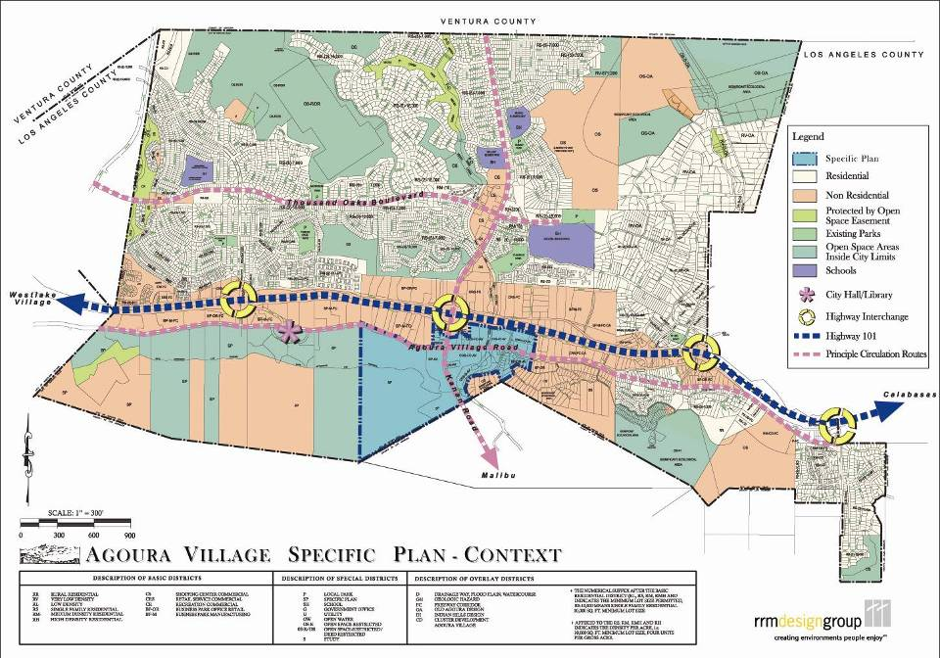
Agoura Village Specific Plan
Agoura Village
Specific Plan Area

Slide 25
AVSP & ADUs and RHNA
 | AVSP | ADUs | Total | RHNA | Difference
Total Units | 293* | 80 | 373 | 318 | ---
Very Low | 21 | 14 | 35 | 127 | (92)
Low | 12 | 34 | 46 | 72 | (26)
Moderate | 12 | 5 | 17 | 55 | (38)
Above Mod | 248 | 27 | 275 | 64 | 211
* Current AVSP max. allowance

Slide 26
Potential Housing Sites
Sites in Agoura Village

Slide 28
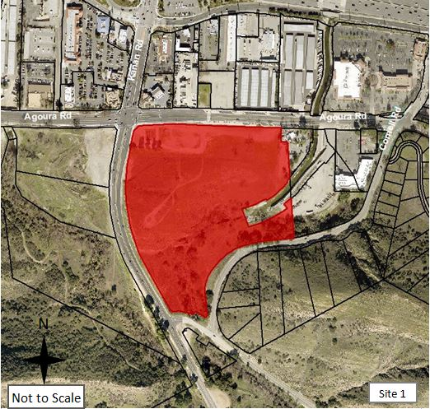
1
2

Slide 32
5
9

Slide 34
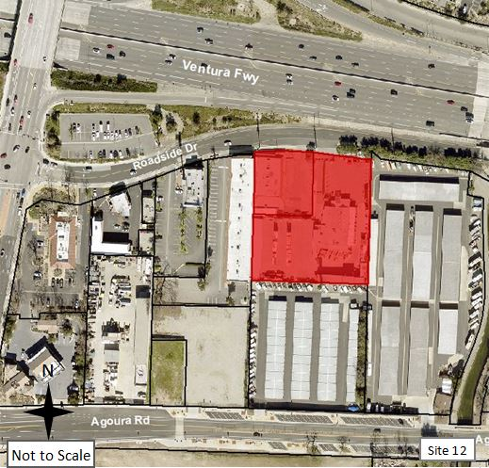

Slide 35
Potential Housing Sites
Sites Outside Agoura Village

Slide 37
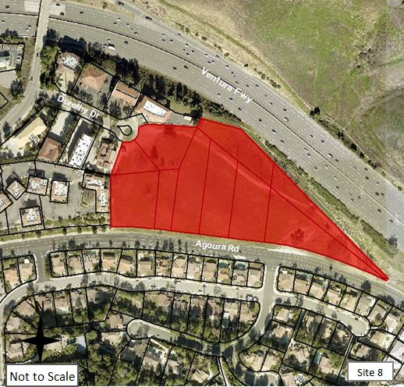

Slide 39
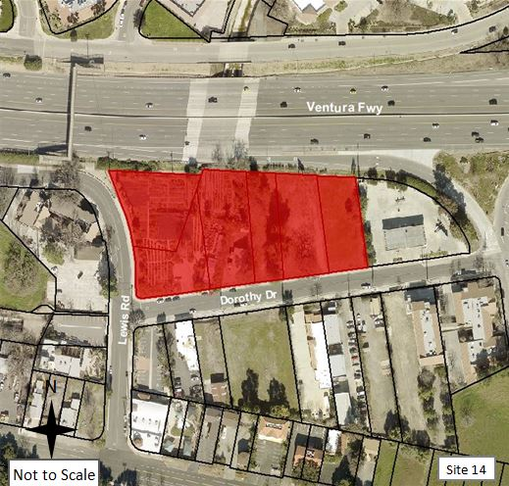

Slide 41
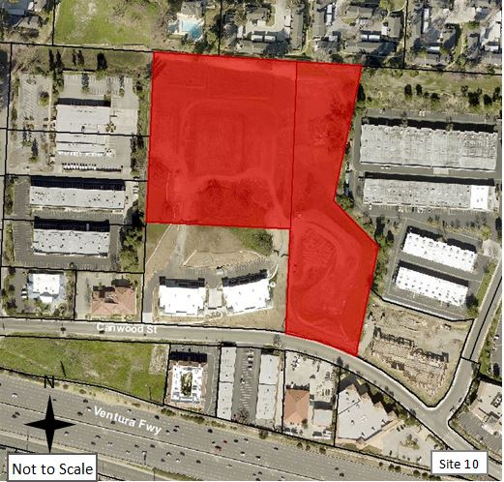

Slide 43
Roadside x 2
patagonia

Slide 45
Agoura meadows
Twin oaks

Slide 47
City mall
Car wash

Slide 49
regan
wallusis

Slide 50
Current Method to Meet RHNA

Slide 51
Inclusionary Housing Policy
City’s primary tool to produce affordable units
Requires projects with 10+ units to provide 15% percent low and moderate income households (min. 7% very low, 4% low, 4% mod)
Allows for an in-lieu fee
Currently, no affordable units in City (non-ADU)

Slide 52
Proposed Approach to Meet RHNA

Slide 53
Affordable Housing Overlay (AHO)
Applying AHO to sites increases housing density (# units that can be developed). State requires by-right processing in exchange for providing an increased % of on-site affordable units beyond City’s inclusionary requirements (20% VL and L vs. 15% VL, L and M).
Property owners would retain the option of developing under base zone district, and not using the AHO.
Re-zone sites to base zone of RM (6-15 du/acre), except mixed-use sites in the AVSP, which would retain the current 20 du/acre density. Shopping centers retain CS-MU base zone.

Slide 54
Affordable Housing Overlay (AHO)
Example: 1 acre RM site | Base Density 15 du/acre | Total Units: 15 Affordable Units IHO: 15% = 2 units | Discretionary Review
 | AHO Density 25 du/acre | Total Units: 25 Affordable Units under AHO: 20% = 5 VL/L units | Non-discretionary/ By Right
New objective development standards would need to be created to support achievement of densities permitted under the AHO and ensure items the City values are maintained.

Slide 55
Proposed Approach
A. Apply AHO Zone to All Sites
B. Re-Zone Base of Sites Outside the AVSP (except Shopping Centers on Kanan Road)
C. Re-Designate AVSP sites

Slide 56
Proposed Approach
APPLY AN AFFORDABLE HOUSING OVERLAY ZONE TO ALL SITES
Dwelling Units per Acre: 20-25
Affordable Units: 10% VL 10% L (total 20%)
Objective Design and Development Standards
3 Different AHO Zones (AVSP, non-AVSP, Shopping Centers), reflecting different objective standards

Slide 57
Proposed Approach
B. CHANGE BASE ZONE OF SITES OUTSIDE AVSP TO MF RESIDENTIAL
Dwelling Units per Acre: 6-15 (RM)
Affordable Units: 7% VL 4% L 4% M (total 15% per IHO)
Objective Design and Development Standards
Exception: Shopping Centers remain CS-MU

Slide 58
Proposed Approach
C. RE-DESIGNATE THE AVSP SITES
Dwelling Units per Acre: 20 DU/AC
Affordable Units: 7% VL 4% L 4% M (15% per IHO)
Objective Design and Development Standards

Slide 59
Proposed Approach
Contributions to RHNA from Proposed Approach
 | DUs from 22 Sites | ADUs | Total DUs Provided | RHNA Needed | Difference
Very Low | 157 | 14 | 171 | 127 | 44
Low | 157 | 34 | 191 | 72 | 119
Moderate | 0 | 5 | 5 | 55 | (50)
Above Moderate | 1,252 | 27 | 1,279 | 64 | 1,215
TOTAL | 1,566 | 80 | 1,646 | 318 | 1,328

Slide 60
7 General Plan Elements
Land Use
Circulation
Safety
Open Space
Conservation
Noise
Housing

Slide 61
Environmental Justice
tice
General Plan
Housing Element
Land Use Element
Circulation Element
Safety Element

Slide 62
Schedule
Draft Housing Element to HCD – Fall 2021 (60-day review by HCD, public review)
Other GP Elements & DEIR prepared – Late Fall 2021
DEIR 45-day public review with GP Elements – Early 2022
Public hearings to consider Housing Element & other Elements, FEIR – Spring 2022

Slide 63
QUESTIONS?

Slide 64
Housing Element Update
A Workshop for the public
August 4, 2021
Notes:
This concludes our workshop for this evening. We appreciate the time you have given us this evening. If you have other questions and comments please feel free to reach out to Allison at acook@agourahillscity.org. Thank you. Travel safely.

